Slide 1
BlackJack
Project one
Phuc Dang & Bogun Kim
CSC 4370

Slide 2
Goals
Visual Clarity
Enable users to recognize and understand with ease
Consistency
Elements that behave the same should look the same
Simplicity
Foundational features

Slide 3
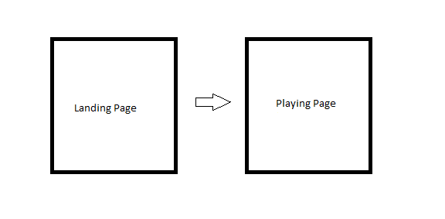
Design: Pages

Slide 4
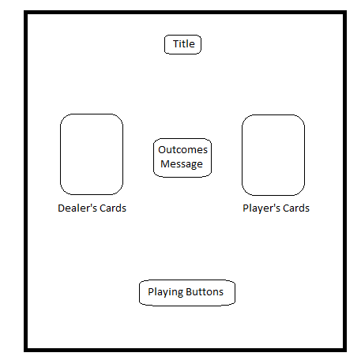
Design: Interface

Slide 5

Landing Page

Slide 6
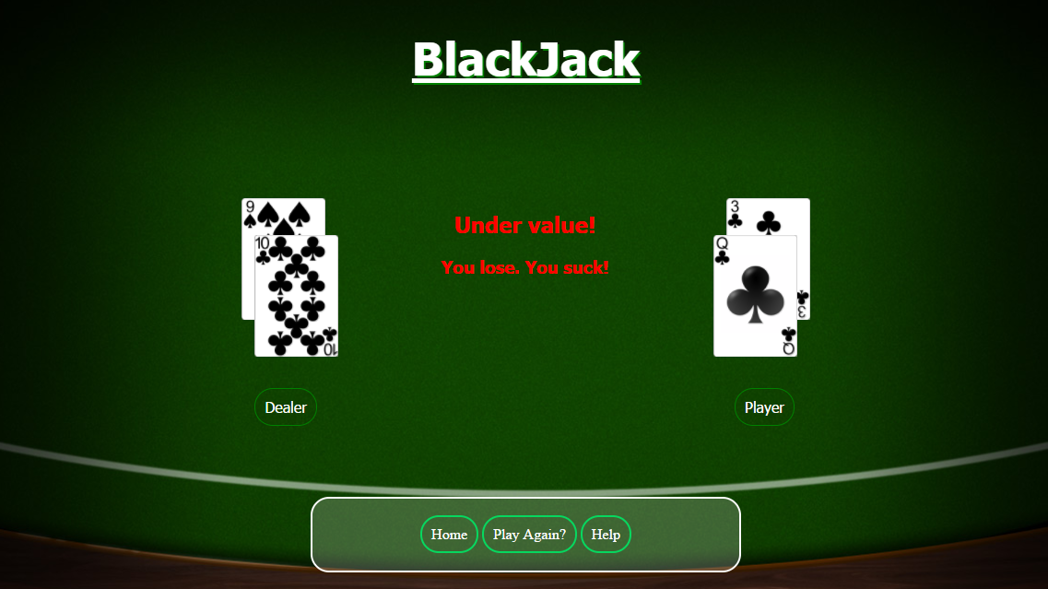
Table Page

Slide 7



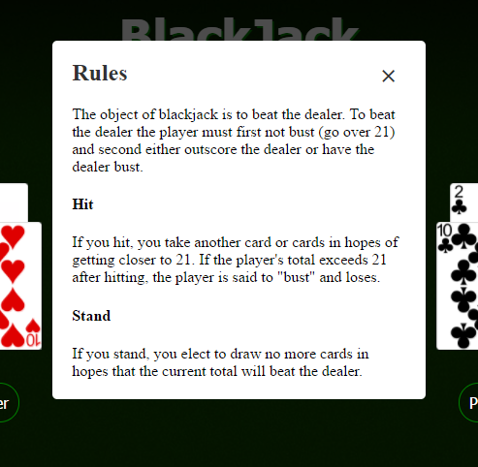
CSS Features:
Animated Button
Popup info box

Slide 8
Animated Button Snippet
HTML:
<a href="board.html">PLAY</a>
CSS:
a {
margin-top: 20%;
text-decoration: none;
padding: 5px 30px 5px 30px;
color: #31302B;
background: #FFF;
padding: 12px 17px;
font-family: 'OpenSansBold', sans-serif;
border: 3px solid #31302B;
font-size: 30px;
font-weight: bold;
border-radius: 12px;
display: inline-block;
box-shadow: inset 0 0 0 0 #31302B;
-webkit-transition: all ease 0.8s;
-moz-transition: all ease 0.8s;
transition: all ease 0.8s;
a:hover {
border: 3px solid #ea2626;
box-shadow: inset 0 100px 0 0 #ea2626;
color: #FFF;
}

Slide 9
Popup Box Snippet
.popupMenu h2 {/* header styling*/
margin-top: 0;
color: #333;
font-family: "Times New Roman", Georgia, Serif;
}
.popupMenu .close {/* Close button styling */
position: absolute;
top: 20px;
right: 30px;
transition: all 200ms;
font-size: 30px;
font-weight: bold;
text-decoration: none;
color: #333;
}
.popupMenu .close:hover {
color: #06D85F;
}
.popupMenu .content {
max-height: 30%;
overflow: auto;
}
@media screen and (max-width: 700px){
.container{
width: 70%;
}
.popupMenu{
width: 70%;
}
}
HTML:
<div class="container">
<a class="button" href="#popupMenu1">Help</a>
</div>
<div id="popupMenu1" class="overlay">
<div class="popupMenu">
<h2>Rules</h2>
<a class="close" href="#">&times;</a>
<div class="content">
The object of blackjack …..
</div>
</div>
CSS
.overlay { /* background styling*/
position: fixed;
top: 0;
bottom: 0;
left: 0;
right: 0;
background: rgba(0, 0, 0, 0.7);
transition: opacity 500ms;
visibility: hidden;
opacity: 0;
}
/* Visibility when clicked*/
.overlay:target {
visibility: visible;
opacity: 1;
}
/* Styling of the popup*/
.popupMenu {
margin: 70px auto;
padding: 20px;
background: #fff;
border-radius: 5px;
width: 30%;
position: relative;
transition: all 5s ease-in-out;
}
Reference : CodeCourse: https://goo.gl/ZzN8d6

Slide 10
Demo
http://codd.cs.gsu.edu/~pdang2/Project1/main/start.html

